Slide 1
SeattlerHub
“Not just to settle, but to be Seattle”
Group 3 Project Final Conclusion
Wen Liao, Houming Leng, Kejian Tong, Zhuocai Li, Jingyi Mao
CS5200 DBMS Fall 2021, December 9th, 2021

Slide 2
Value Proposition
SeattlerHub is a housing recommendation app that provides suggestions for users on where to live in Seattle, especially new residents.
To achieve differentiation with other house listing apps, instead of focusing on housing’s quality, we focus more on the house’s neighborhood environment:
security levels
nearyby restaurants
public / private schools
entertainment spots
schools
Wen Liao, Houming Leng, Kejian Tong, Zhuocai Li, Jingyi Mao
DBMS Project Milestone 6, Group 3 - 12/09/2021

Slide 3
Features Overview
Final App:
Initial Plan:
Personalized search;
Rating or commenting on current living units/community/district;
Registration / Authentication
Personalized search;
Rating or commenting on current living units/community/district;
Finding friends living in the same neighborhood
Wen Liao, Houming Leng, Kejian Tong, Zhuocai Li, Jingyi Mao
DBMS Project Milestone 6, Group 3 - 12/09/2021

Slide 4
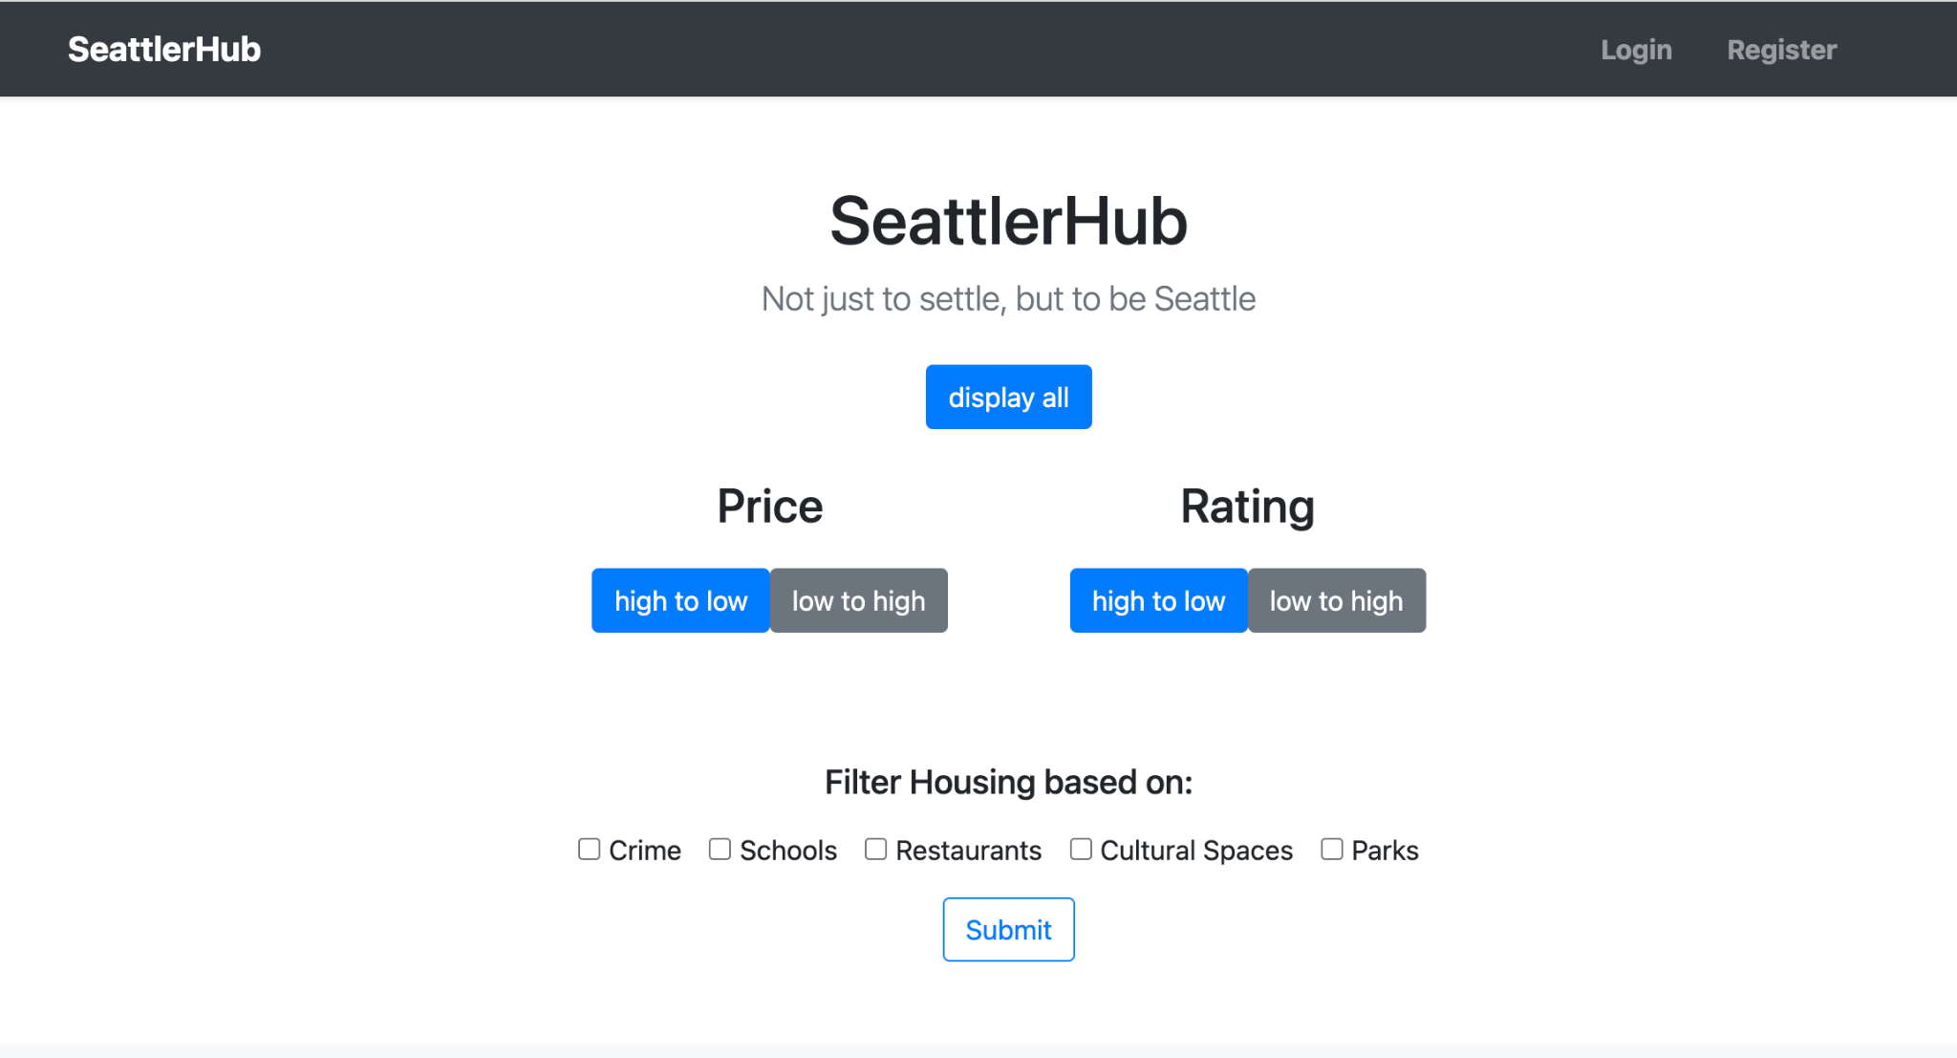
Features - Personalized Search
Wen Liao, Houming Leng, Kejian Tong, Zhuocai Li, Jingyi Mao
DBMS Project Milestone 6, Group 3 - 12/09/2021

Slide 5
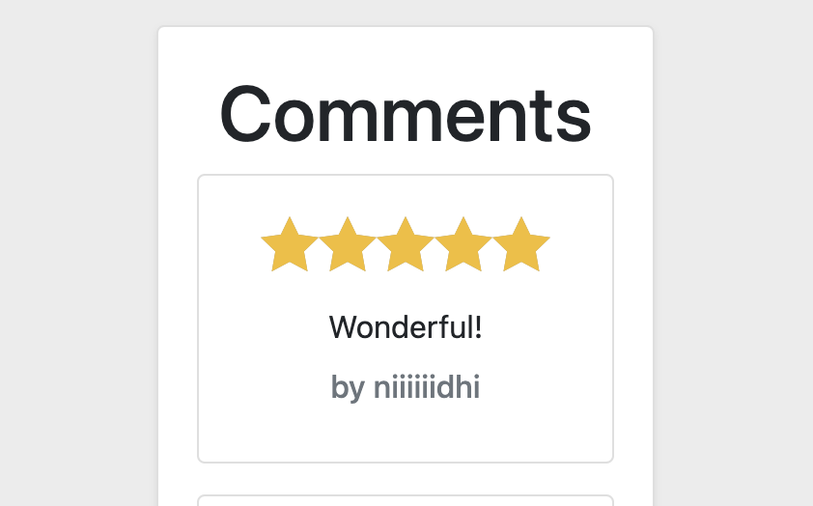
Features - Rating / Commenting
Wen Liao, Houming Leng, Kejian Tong, Zhuocai Li, Jingyi Mao
DBMS Project Milestone 6, Group 3 - 12/09/2021

Slide 6
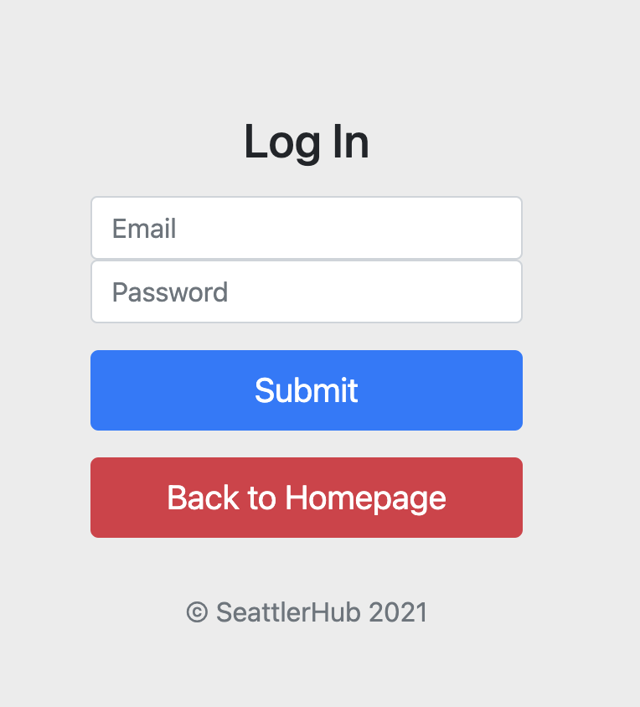
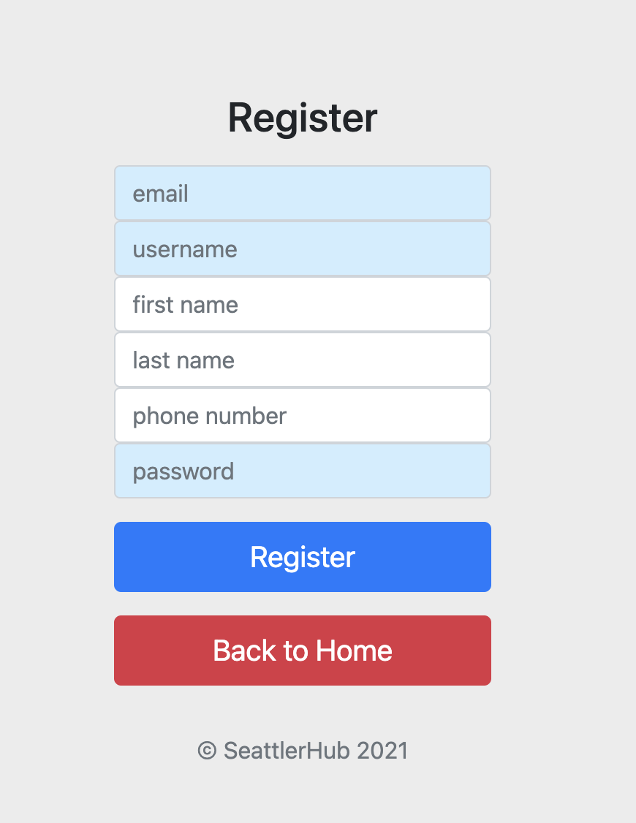
Features - Registration / Authentication
Wen Liao, Houming Leng, Kejian Tong, Zhuocai Li, Jingyi Mao
DBMS Project Milestone 6, Group 3 - 12/09/2021

Slide 7
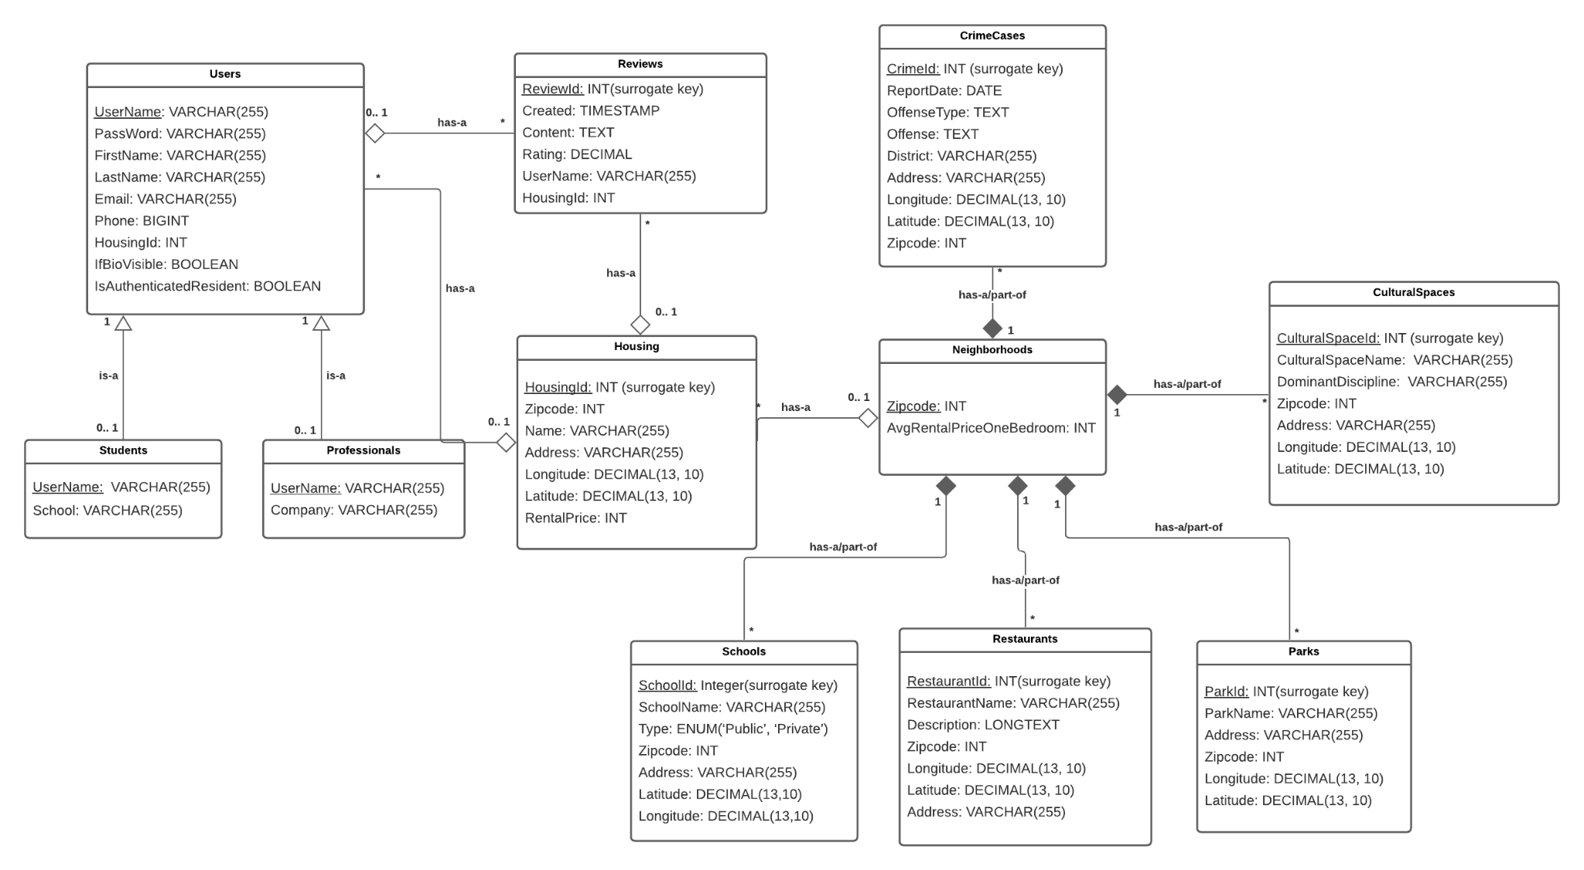
Final UML
Wen Liao, Houming Leng, Kejian Tong, Zhuocai Li, Jingyi Mao
DBMS Project Milestone 6, Group 3 - 12/09/2021

Slide 8
3-Month Workflow - We Nailed It!
We showed strong teamwork and everybody fulfilled individual work perfectly:
had a good project blueprint and successfully constructed the UML;
successfully built relational models and inserted data;
generated multiple SQL statements to filter out the housings based on different neighbourhood environments;
built both frontend and backend with advanced features;
designed an expandable application: external data can be imported later.

Slide 9
Critical Thinking
Server Side: NoSQL might be better?
Since the main part of our project is about the specific details about housings and also people would care a lot about previous residents comments, a NoSQL storage would be a better choice to this concern.
Client Side: JSP too out-dated?
A better decorated web page may lead to more users’ attraction. JSP is hard to grasp the core in limited time while we had no knowledge of this frontend tech. It is also out-dated and other modern techniques such as React or VUE would certainly be a better choice if applied.
Wen Liao, Houming Leng, Kejian Tong, Zhuocai Li, Jingyi Mao
DBMS Project Milestone 6, Group 3 - 12/09/2021

Slide 10
Next Steps
Not just a DBMS
A public website which would lead to practical business benefits. More REST APIs & user-friendlier UI/UX should be taken into consideration.
More features
Search engines, more filter options, chatting bots, cluster maps, etc.
More expandable server and storage
While a much heavier app has been constructed, we will require much more APIs with different usages that provide varied functionalities. Our schemas and models might expand since more data will be joined.
Wen Liao, Houming Leng, Kejian Tong, Zhuocai Li, Jingyi Mao
DBMS Project Milestone 6, Group 3 - 12/09/2021

Slide 11
SeattlerHub
Group 3 Project Final Conclusion
Wen Liao, Houming Leng, Kejian Tong, Zhuocai Li, Jingyi Mao
CS5200 DBMS Fall 2021, December 9th, 2021

